Slide 1
Marketing Requirements Review (MRR)
“Better Troffer” FLX/ZRMT
Jeff Hungarter
Form: QLP5.29B Rev -

Slide 2
Marketing Requirements Review Gate Objectives
Marketing Requirements Review (MRR)
Owner: Jeff Hungarter
Product Requirements Review (PRR)
Owner: TBD
Design Review (DR)
Owner: TBD
Do we move forward with an opportunity and spend money?
Readiness to develop concepts
Do we move forward to spend money to do product design & testing?
Readiness to initiate project
Do we move forward to spend money to qualify the design solution?
Readiness for design verification
Design Complete Review (DCR)
– f.k.a. QR –
Owner: TBD
Production Readiness Review (PR2)
Owner: TBD
Commercial Launch
Review (CLR)
– f.k.a. MLR –
Owner: TBD
Do we freeze the design and move forward to spend money to tool the project?
Readiness for supplier & manufacturing process verification
Do we have a fully certified/ qualified product and are ready to move forward to spend money to build launch inventory?
Readiness to build launch inventory
Do we move forward to take orders and ship?
Readiness to announce to market and take orders

Slide 3
Agenda
Executive Summary
Project Overview
Product Overview
Competitive Landscape
Value Prop/Market Review
Financial Summary
Risks
Key Project Metrics
Project Schedule Metrics
Summary Review
Form: QLP5.29B Rev -

Slide 4
Executive Summary:
Simplify and expand Cree’s “Better Troffer” portfolio to regain market share and relevancy in education and healthcare where higher lumen packages are required
Improve troffer operational efficiency and supply continuity
Strengthen controls position through increased partnership with various Lutron controls and by adding new tunable white Smartcast option for higher end specification RFQ’s

Slide 5
Project Objective
Current | Proposed | Positioning | Specs | Proposed Path
C-Lite Basket | C-Lite Basket | Value | Maintain Current Specs | OEM
ZR-C | ZR Good | Good | 80 CRI, DLC Premium, 5 Year Warranty, OCC Sensor, WIM/VIVE Fixed CCT | ODM
ZR-FD | EOL
ZR-MT | FLX- ZR Lens FLX- FLX Lens FLX- SQ Lens | Better | DLC Standard 90 CRI, DLC Premium 80 CRI, 10 Year Warranty, WIM ACK CMA/VIVE + Lutron Controls Expanded Lumen Packages Factory Installed options | Cree Engineering
FLX

Slide 6
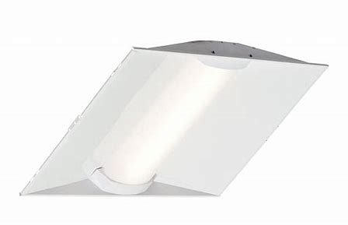
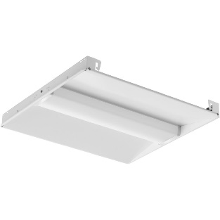
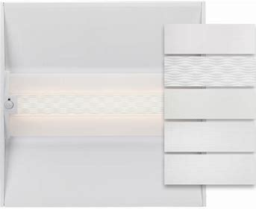

“Better Troffer” Product Overview
NA | EMEA | APAC | LATAM
Y | N | N | N
Project Description:
Project type: Product Expansion
Combine FLX and ZRMT platforms into one product family to improve operational efficiencies, while adding more competitive features such as more lumen options, control options, and factory installed options to re-gain market share
Project Market Drivers:
Target Market: Commercial Spaces
Target Application: Office Space, School classrooms, Healthcare spaces (non-patient)
Sales Channel Focus: Specification, C&I, National Accounts
Key Product Features:
More lumen options from 2000 up to 10,000 lumens to go after education and healthcare opportunities currently missed
Increase market share by offering more control packages to play in spaces where control is spec’d feature such as Lutron
Offer more dynamic white color tunable options to meet the growing trends and offer complimentary products to Cadiant
Financial Estimates | Sales ($M) | GM (%)
Year 1 | $19.8 | 37.7%
Year 2 | $23.9 | 37.7%
Year 3 | $25.1 | 37.7%
Project Cost Estimates*
Start-up: $
Investment: $
ROI: %
Payback: years
* to be completed for PRR
KPI | MRR | PRR | DR | QR | PR2 | MLR
GM% | 37.7%
Payback
TTM | March 2020 (Phase 1)
Form: QLP5.29B Rev -
Notes:
Changes are to be highlighted from previous presentation

Slide 7
New FLX Ordering Tree
See Attached PRS document for more details

Slide 8
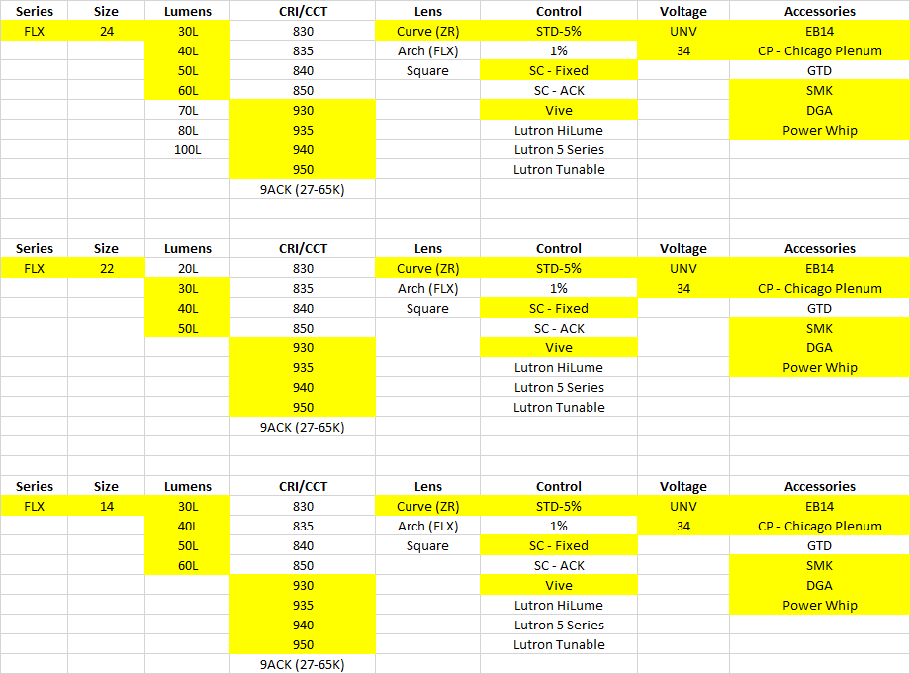
New FLX Priority #1
Plan to release all phases by July 2020
Accessories
Factory Installed
EB14
CP
Power Whip
Field Installed
SMK
DGA
Field Install Drivers

Slide 9
Competitive Landscape

Slide 10
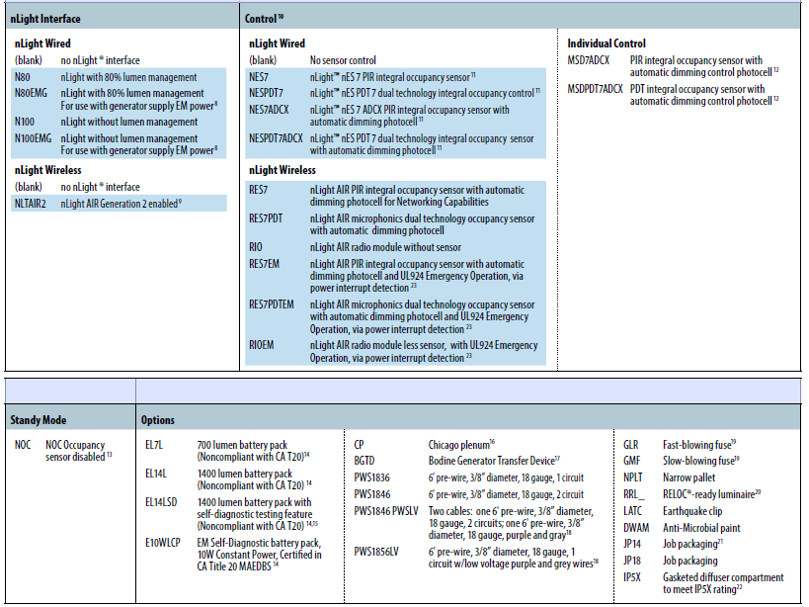
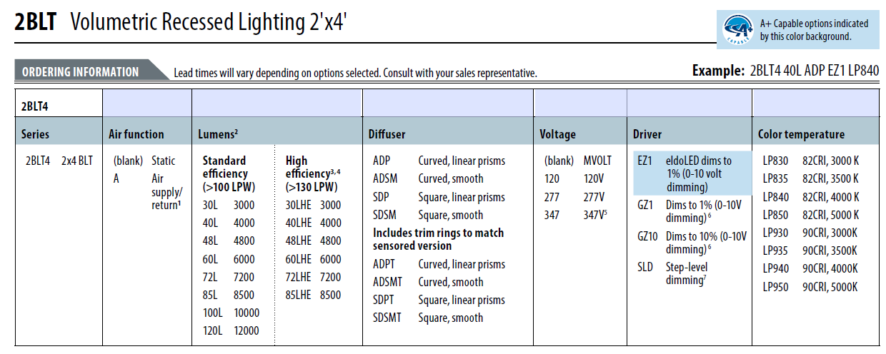
Competitive Overview #1
Acuity BLT
https://img.acuitybrands.com/public-assets/catalog/456337/blt-2x4.pdf?abl_version=10%2f29%2f2019+16:08:57&DOC_Type=SPEC_SHEET

Slide 11
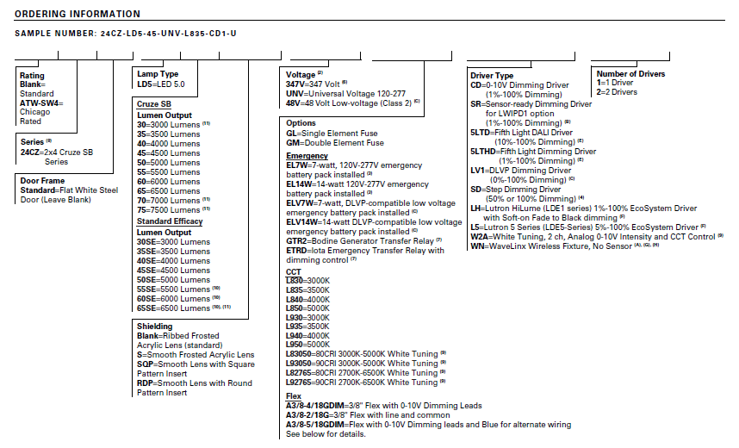
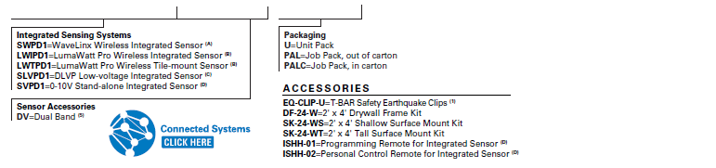
Competitive Overview #2
Cooper CRUZ SB
http://www.cooperindustries.com/content/dam/public/lighting/products/documents/metalux/spec_sheets/metalux-cruze-sb-led-2x4-specsheet.pdf

Slide 12
Value Prop/Market Review
Form: QLP5.29B Rev -

Slide 13
Market Review
Market:
Makes Cree relevant again in the commercial/spec troffer space
Cree:
Allows Cree to bid for and hold more specification projects in spaces such as education, healthcare, and office spaces
Improves relationship and hit rate with agents looking to use Cree in more jobs
Allows pull through troffer revenue when other controls are specified like Lutron or Audacy

Slide 14
Financial Summary
Form: QLP5.29B Rev -

Slide 15
Volume Projections
Volume Projection Support
New lumen, control, and factory installed accessories support increased volume
Increased market share- regaining what we lost and opening education market
Cannibalization:
FLX Curve replaces ZRMT
FLX Arch Replaces FLX Standard
FLX Square is incremental
Form: QLP5.29B Rev -

Slide 16
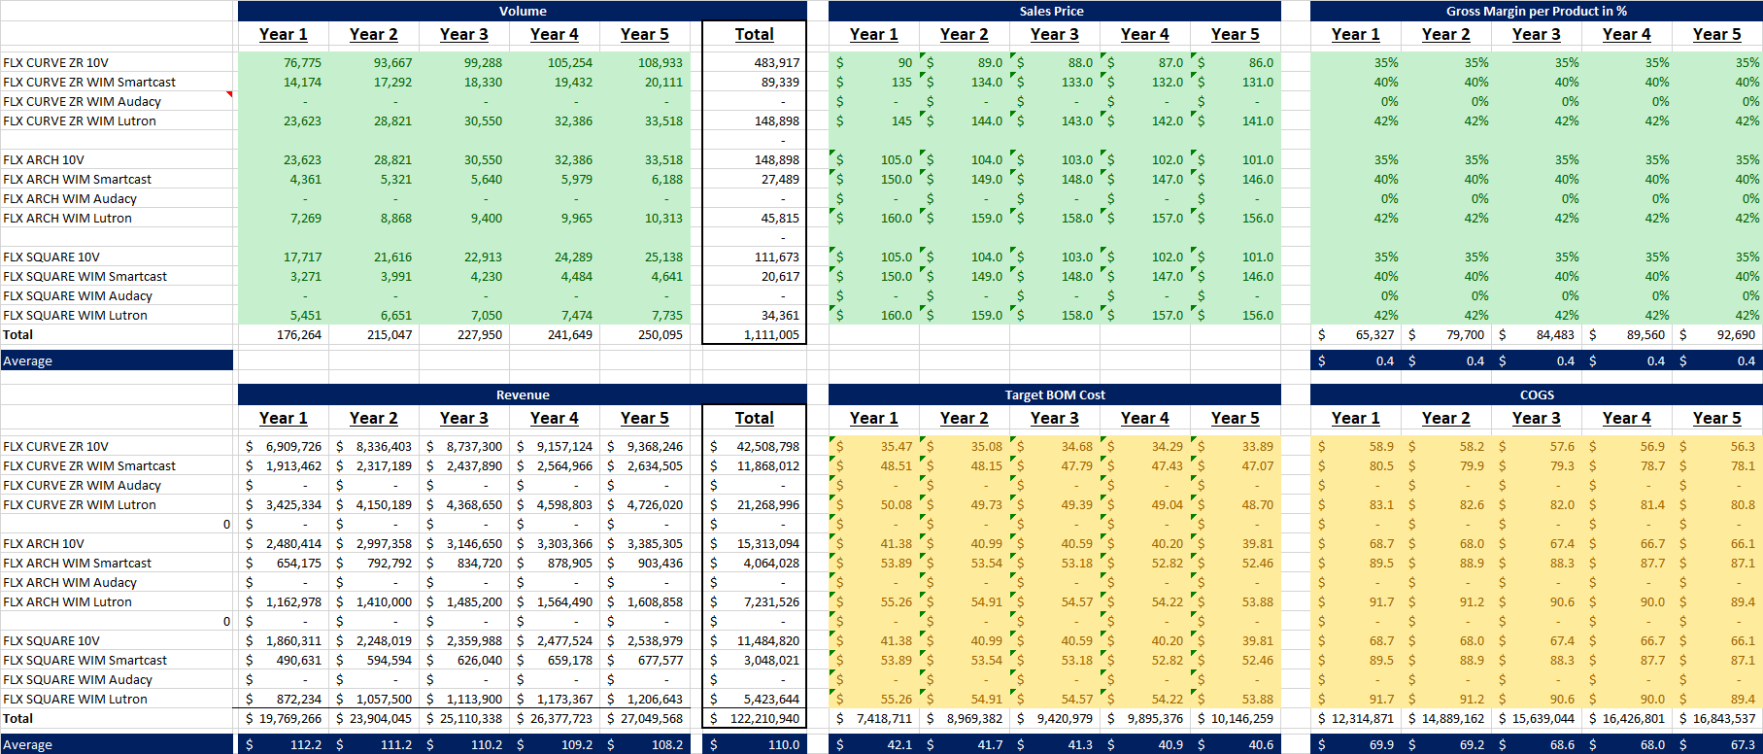
Business Case Overview

Slide 17
Financial Summary
Insert link to QLP5.29C
Assumptions
Assumes Phased Approach over next 12 months with first phase launched March 2020
Assumes ability to hit cost targets, specifically for ZRMT
Assumes ASP market decline of ~ 2%
Form: QLP5.29B Rev -

Slide 18
Business Unit Risk Assessment
Form: QLP5.29B Rev -

Slide 19
Risks
Timing: This needs to be ready to ship by March 2020
Continuity of Product: Need to manage the transition specifically for Phase 1 to continue to deliver a steady flow of existing products and make the move as seamless to customers as possible
Cost: While we shouldn’t look at cost alone due to improved efficiencies and loading of the factory, we need to be cautious on ZRMT line as that is largest volume and most price sensitive
Timing: This needs to be ready to ship by March 2020
Glare Requirement: DLC Premium V5 Draft potentially adding UGR requirement that could pose issues for meeting Premium level for ZR and FLX

Slide 20
Key Project Metrics
Form: QLP5.29B Rev -

Slide 21
Key Project Metrics
Speed to Market for Phase 1
Project Schedule / Time to Market – March 2020
Critical to create smooth transition of existing ZRMT line to FLX Curve
Release remaining phases by July 2020
Product Cost / GM% - ~37.7%
Need to review fully loaded ZRMT (Curve) costs to meet 35% GM

Slide 22
Requested Project Schedule Targets
Requested Timing Alignment
MRR Approval: October 2019
PRR Approval: November 2019
Commercial Launch Review (Phase 1) March 2020 (All by July 2020)

Slide 23
“Better Troffer” Product Overview
NA | EMEA | APAC | LATAM
Y | N | N | N
Project Description:
Project type: Product Expansion
Combine FLX and ZRMT platforms into one product family to improve operational efficiencies, while adding more competitive features such as more lumen options, control options, and factory installed options to re-gain market share
Project Market Drivers:
Target Market: Commercial Spaces
Target Application: Office Space, School classrooms, Healthcare spaces (non-patient)
Sales Channel Focus: Specification, C&I, National Accounts
Key Product Features:
More lumen options from 2000 up to 10,000 lumens to go after education and healthcare opportunities currently missed
Increase market share by offering more control packages to play in spaces where control is spec’d feature such as Lutron
Offer more dynamic white color tunable options to meet the growing trends and offer complimentary products to Cadiant
Financial Estimates | Sales ($M) | GM (%)
Year 1 | $19.8 | 37.7%
Year 2 | $23.9 | 37.7%
Year 3 | $25.1 | 37.7%
Project Cost Estimates*
Start-up: $
Investment: $
ROI: %
Payback: years
* to be completed for PRR
KPI | MRR | PRR | DR | QR | PR2 | MLR
GM% | 37.7%
Payback
TTM | March 2020 (Phase 1)
Form: QLP5.29B Rev -
Notes:
Changes are to be highlighted from previous presentation

